Slide 1
Web Systems and Algorithms
Unit 5
Classification : Placing Thing Where They Belong

Slide 2
Classification vs. Prediction
Classification
predicts categorical class labels
classifies data based on the training set and the values (class labels) in a classifying attribute and uses it in classifying new data
Prediction
predicts unknown or missing values
Typical applications
Credit approval
Target marketing
Medical diagnosis
Fraud detection

Slide 3
Classification—A Two-Step Process
Model construction: describing a set of predetermined classes
Each tuple/sample is assumed to belong to a predefined class, as determined by the class label attribute
The set of tuples used for model construction is training set
The model is represented as classification rules, decision trees, or mathematical formulae
Model usage: for classifying future or unknown objects
Estimate accuracy of the model
The known label of test sample is compared with the classified result from the model
Accuracy rate is the percentage of test set samples that are correctly classified by the model
Test set is independent of training set, otherwise over-fitting will occur
If the accuracy is acceptable, use the model to classify data tuples whose class labels are not known

Slide 4
Process (1): Model Construction
Classification
Algorithms
Training
Data
Classifier
(Model)
IF rank = ‘professor’
OR years > 6
THEN tenured = ‘yes’

Slide 5
Process (2): Using the Model in Prediction
Classifier
Testing
Data
Unseen Data
(Jeff, Professor, 4)
Tenured?

Slide 6
Issues: Data Preparation
Data cleaning
Preprocess data in order to reduce noise and handle missing values
Relevance analysis (feature selection)
Remove the irrelevant or redundant attributes
Data transformation
Generalize and/or normalize data

Slide 7
Issues: Evaluating Classification Methods
Accuracy
classifier accuracy: predicting class label
predictor accuracy: guessing value of predicted attributes
Speed
time to construct the model (training time)
time to use the model (classification/prediction time)
Robustness: handling noise and missing values
Scalability: efficiency in disk-resident databases
Other measures, e.g., goodness of rules, such as decision tree size or compactness of classification rules

Slide 8
Classification Algorithm
Baye's Theorem
Decision Trees
Back Propagation Algorithm
KNN
Rocchio Algorithm

Slide 9

Bayesian methods
Learning and classification methods based on probability theory.
Baye’s theorem plays a critical role in probabilistic learning and classification.
Uses prior probability of each category given no information about an item.
Categorization produces a posterior probability distribution over the possible categories given a description of an item.
P(A|B) =

Slide 10
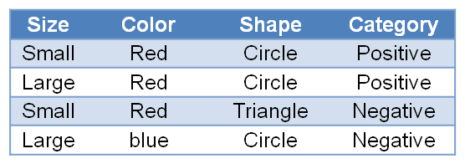
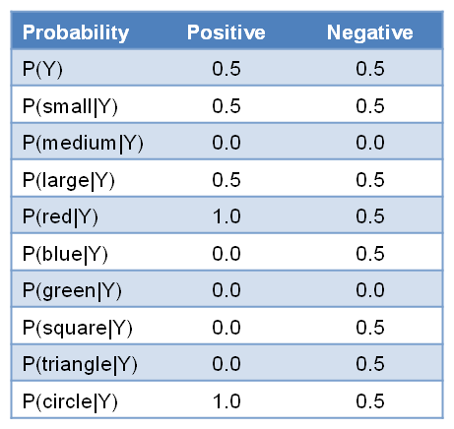
Bayesian methods...
AFTER TRAINING
D =
Size<small, medium, large>
Color<red, blue, green>
Shape<circle, triangle, square>
Category<positive, negative>

Slide 11
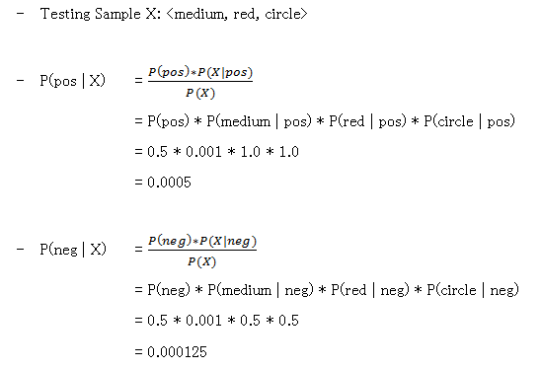
Bayesian methods...

Slide 12
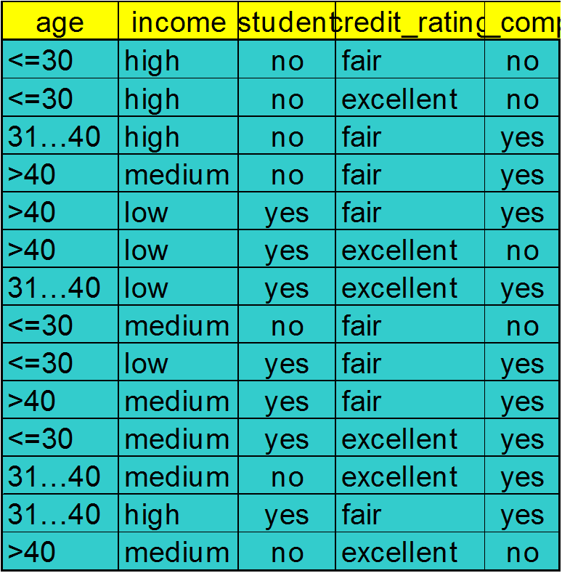
Naïve Bayesian Classifier: Training Dataset
Class:
C1:buys_computer = ‘yes’
C2:buys_computer = ‘no’
Data sample
X = (age <=30,
Income = medium,
Student = yes
Credit_rating = Fair)

Slide 13
Naïve Bayesian Classifier: An Example
P(C_{i}): P(buys_computer = “yes”) = 9/14 = 0.643
P(buys_computer = “no”) = 5/14= 0.357
Compute P(X|C_{i}) for each class
P(age = “<=30” | buys_computer = “yes”) = 2/9 = 0.222
P(age = “<= 30” | buys_computer = “no”) = 3/5 = 0.6
P(income = “medium” | buys_computer = “yes”) = 4/9 = 0.444
P(income = “medium” | buys_computer = “no”) = 2/5 = 0.4
P(student = “yes” | buys_computer = “yes) = 6/9 = 0.667
P(student = “yes” | buys_computer = “no”) = 1/5 = 0.2
P(credit_rating = “fair” | buys_computer = “yes”) = 6/9 = 0.667
P(credit_rating = “fair” | buys_computer = “no”) = 2/5 = 0.4
X = (age <= 30 , income = medium, student = yes, credit_rating = fair)
P(X|C_{i}) : P(X|buys_computer = “yes”) = 0.222 x 0.444 x 0.667 x 0.667 = 0.044
P(X|buys_computer = “no”) = 0.6 x 0.4 x 0.2 x 0.4 = 0.019
P(X|C_{i})*P(C_{i}) : P(X|buys_computer = “yes”) * P(buys_computer = “yes”) = 0.028
P(X|buys_computer = “no”) * P(buys_computer = “no”) = 0.007
Therefore, X belongs to class (“buys_computer = yes”)

Slide 14
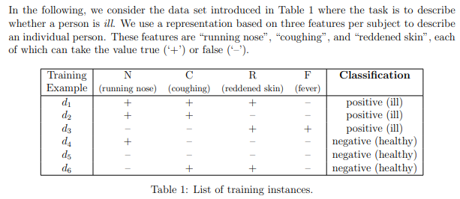
Bayesian Classifier…………………….
Classify the following
d7 = (¬N,C, ¬ R,F)
d8 = (N, ¬ C, ¬ R,F)
d9 = (N, ¬ C,R, ¬ F)

Slide 15
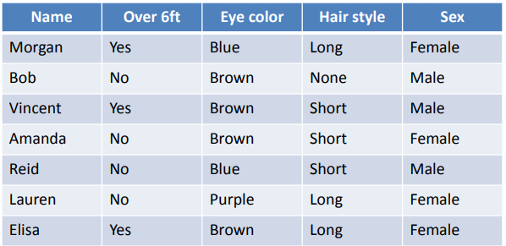

Bayesian Classifier…………………….

Slide 16
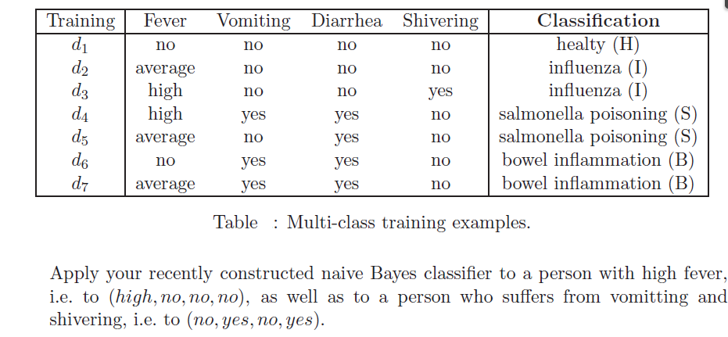
Bayesian Classifier…………………….

Slide 17
Decision Trees
Decision tree induction is the learning of decision trees from class labeled training tuples.
A decision tree is a flowchart like tree structure where each internal node denotes a test on an attribute, each branch represents an outcome of the test and each node holds a class label

Slide 18
Decision Trees...
Age ?
youth
senior
Student ?
middle-aged
Credit_rating ?
no
yes
fair
excellent
YES
NO
YES
NO
YES

Slide 19
Decision Trees...(Example)
Day | Outlook | Temperature | Humidity | Wind | Play Tennis
D1 | SUNNY | HOT | HIGH | WEAK | NO
D2 | SUNNY | HOT | HIGH | STRONG | NO
D3 | OVERCAST | HOT | HIGH | WEAK | YES
D4 | RAIN | MILD | HIGH | WEAK | YES
D5 | RAIN | COOL | NORMAL | WEAK | YES
D6 | RAIN | COOL | NORMAL | STRONG | NO
D7 | OVERCAST | COOL | NORMAL | STRONG | YES
D8 | SUNNY | MILD | HIGH | WEAK | NO
D9 | SUNNY | COOL | NORMAL | WEAK | YES
D10 | RAIN | MILD | NORMAL | WEAK | YES
D11 | SUNNY | MILD | NORMAL | STRONG | YES
D12 | OVERCAST | MILD | HIGH | STRONG | YES
D13 | OVERCAST | HOT | NORMAL | WEAK | YES
D14 | RAIN | MILD | HIGH | STRONG | NO
Outlook <sunny, overcast, rain>
Temperature <hot, mild, cool>
Humidity <high, normal>
Wind <weak, strong>
Play Tennis <no, yes>

Slide 20
BUILDING DECISION TREE
Humidity
high
normal
d1,d2,d3,d4,d8,d12,d14
d5,d6,d7,d9,d10,d11,d13
Wind
Outlook
strong
weak
sunny
overcast
rain
d2,d12,d14
d1,d3,d4,d8
d9,d11
d5,d6,d10
d7,d13
Outlook
Outlook
yes
Wind
yes
sunny
overcast
strong
weak
rain
sunny
overcast
d2
d12
rain
d6
d5,d10
no
d14
yes
no
yes
no
d1,d8
d4
d3
no
yes
yes
Testing : <sunny, hot, normal, weak> → YES

Slide 21
Information gain
ID3 uses information gain as its attribute selection measure
Based on the value or “information content” of messages
Let node N represent or hold the tuples of partition D
The attribute with the highest information gain is chosen as the splitting attribute for node N
This attribute minimizes the information needed to classify the tuples in the resulting partitionsbb

Slide 22
Information gain...
Select the attribute with the highest information gain
Let p_{i} be the probability that an arbitrary tuple in D belongs to class C_{i}, estimated by |C_{i, D}|/|D|
Expected information (entropy) needed to classify a tuple in D:
Information needed (after using A to split D into v partitions) to classify D:
Information gained by branching on attribute A
Notes:
I : the expected information needed to classify a given sample
E (entropy) : expected information based on the partitioning into subsets by A

Slide 23
Attribute Selection: Information Gain
Class P: buys_computer = “yes”
Class N: buys_computer = “no”
means “age <=30” has 5 out of 14 samples, with 2 yes’es and 3 no’s. Hence
Similarly,

Slide 24
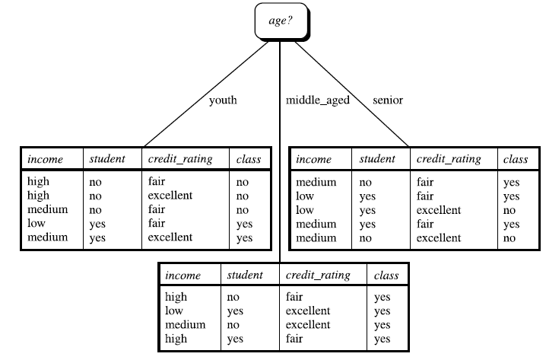
Information gain....
Because age has the highest information gain among the attributes, it is selected as the splitting attribute

Slide 25
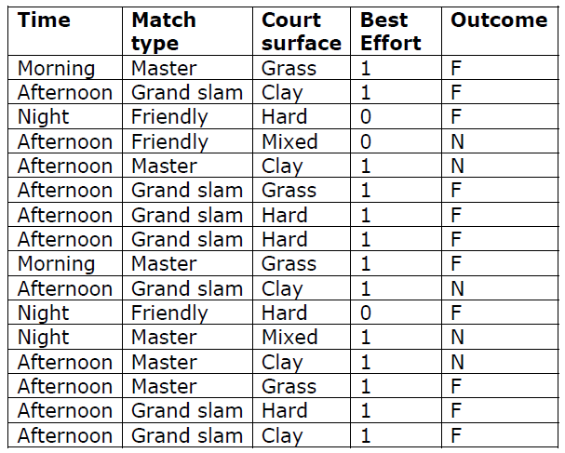
Decision Tree (Exercise)

Slide 26
Classification by Backpropagation
Backpropagation: A neural network learning algorithm
Started by psychologists and neurobiologists to develop and test computational analogues of neurons
A neural network: A set of connected input/output units where each connection has a weight associated with it
During the learning phase, the network learns by adjusting the weights so as to be able to predict the correct class label of the input tuples
Also referred to as connectionist learning due to the connections between units

Slide 27
A Multi-Layer Feed-Forward Neural Network
Output vector
Output layer
Hidden layer
w_{ij}
Input layer
Input vector: X

Slide 28
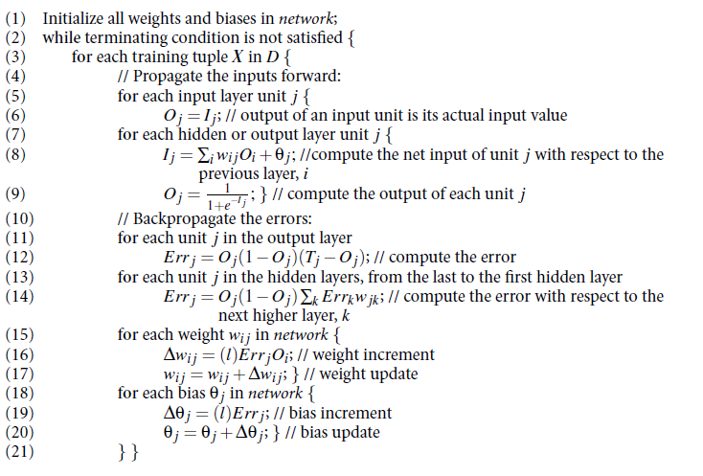
Algorithm

Slide 29
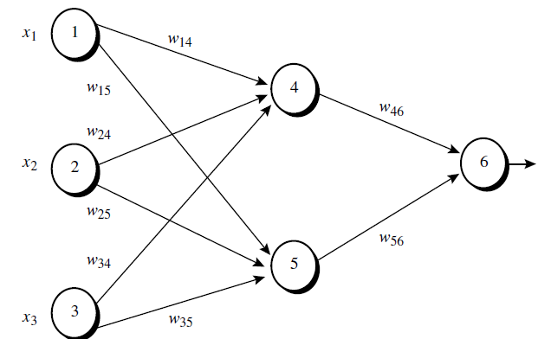
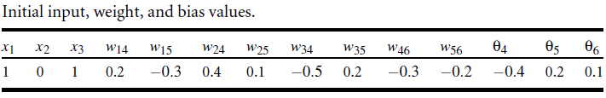
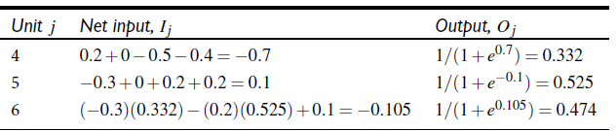
Example
Trace for O4
I4=O1*W14+O2*W24+O3*W34+θ4
I4=1*0.2+0*0.4+1*(-0.5)+(-0.4)=-0.7
O4=1/(1+e∧-I4)=1/(1+e∧0.7)=0.332
Repeat Until Err6 ≈ 0
W14(new)=W14(old)+(0.9)*Err4*O1
W15(new)=W15(old)+(0.9)*Err5*O1
……….So on
Update the weight
Step 1:- Initialize Input, Weight and Bias
Err6 = O6(1-O6)(T-O6)=O6(1-O6)(1-O6)
Err5 = O5(1-O5) * Err6 * W56
Err4 = O4(1-O4) * Err6 * W46
Step 3:- Calculate the Error
Step 2:- Calculate the output
For input layer
O1=x1=1, O2=x2=0, O3=x3=1
For hidden and output layer

Slide 30
Overfitting and Underfitting
Overfitting
Due to excess knowledge of attributes where the model tries to use all the attributes
Large training set but unseen testing data
Underfitting
Due to lack of enough attributes, model doesn't has enough knowledge and gives incorrect results
Less training data set

Slide 31
K – Fold Cross Validation
Cross validation is the model validation technique for accessing how the result of the statistical analysis will generalize to an independent data set
In k-fold cross-validation, the original sample is randomly partitioned into k equal sized sub samples
Of the k subsamples, a single subsample is retained as the validation data for testing the model, and the remaining k − 1 subsamples are used as training data
i.e. if k = 5, (5 – fold validation), first divide the data into 5 equal parts, then use 4 parts for training and 1 part for testing

Slide 32
Rocchio Algorithm
Training Algorithm
Assume the set of categories is {c₁, c₂,........., c_{n}}
For i = 1 to n
let Pi = <0, 0,...., 0> (initial prototype vectors
For each training example x, let d be the normalized TF/IDF term vector for document x
For all i, P_{i}= P_{i}i + d
Testing Algorithm
Given test document x
Let d be the TF/IDF weighted vector for x
m = -1
For i = 1 to n
Let s = cossim(d, P_{i}) → compute similarity to each prototype
if (s>m)
{ m = s;
r = c_{i}i; → update with most closest class }
Loop
Return class r

Slide 33
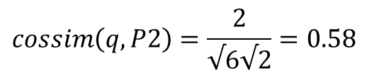
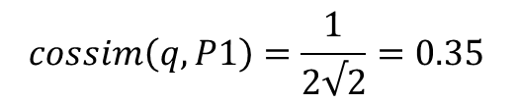
Rocchio Algorithm……………………….
Example
Food: “Turky stuffing” → d1
Food: “Buffalo wings”→ d2
Beverage: “Cream soda”→ d3
Beverage: “Orange soda”→ d4
Apply the Rocchio algorithm to classify a new name “Turky Soda”→ q
No. of distinct terms → “turky, stuffing, buffalo, wings, cream, soda, orange”
Vectors (TF)
d1→ (1,1,0,0,0,0,0)
d2 → (0,0,1,1,0,0,0)
d3 → (0,0,0,0,1,1,0)
d4 → (0,0,0,0,0,1,1)
q → (1,0,0,0,0,1,0)
P1 = d1 + d2 = (1,1,1,1,0,0,0)
P2 = d3 + d4 = (0,0,0,0,1,2,1)
$$cossim\left(q,P1\right)=\frac{1}{2√2}=0.35$$
$$cossim\left(q,P2\right)=\frac{2}{√6√2}=0.58$$

Slide 34
KNN (K – Nearest Neighbor)
Training Algorithm
For each training example <x, c(x)> ∈ D (Training Dataset)
Compute the corresponding TF-IDF vector d_{x} for document x
Testing Algorithm
For testing instance y
Compute TF-IDF vector d for document y
For each <x, C(x)>∈D
S_{x} = cossim(d,d_{x})
Sort x, in D by decreasing value of S_{x}
Let N be the first K examples in D
Return the majority class of examples in N

Slide 35
KNN Algorithm (K=3)…………………
Example
Food: “Turky stuffing” → d1
Food: “Buffalo wings”→ d2
Beverage: “Cream soda”→ d3
Beverage: “Orange soda”→ d4
Apply the KNNalgorithm to classify a new name “Turky Soda”→ q
No. of distinct terms → “turky, stuffing, buffalo, wings, cream, soda, orange”
Vectors (TF)
d1→ (1,1,0,0,0,0,0)
d2 → (0,0,1,1,0,0,0)
d3 → (0,0,0,0,1,1,0)
d4 → (0,0,0,0,0,1,1)
q → (1,0,0,0,0,1,0)
Sim(q,d1)=((1)/(√2 * √ 2))=1/2=0.5
Sim(q,d2)=0
Sim(q,d3)=0.5
Sim(q,d4)=0.5
Sort the values in descending order
0.5 (Food)
0.5 (Beverage)
0.5 (Beverage)
0 (Food)
Beverage
Find the majority
among top K(3)

Slide 36
End of Session

